Slide 1


Analysis of Gulliver’s Travels
Based on chapter VI &VII
Presented by *** & ***

Slide 2
CONTENT
1
2
3
4
2
Part One
Part Two
Part Three
Part Four
Main contents
Contents we’re interest in
Gulliver’s Travels
&
Multiculturalism
Perspectives about the writing style of Gulliver’s Travels

Slide 3
CONTENT
1
2
3
4
2
Part One
Part Two
Part Three
Part Four
Main contents
Contents we're interested in
Gulliver’s Travels
&
Multiculturalism
Perspectives about the writing style

Slide 4
1
Main contents
Chapter VI
Audience 1-5: Gulliver introducing the English society
General social situation (territory, colonies, and climate)
Composition of the English parliament
The court of justice
The management of treasury

Slide 5
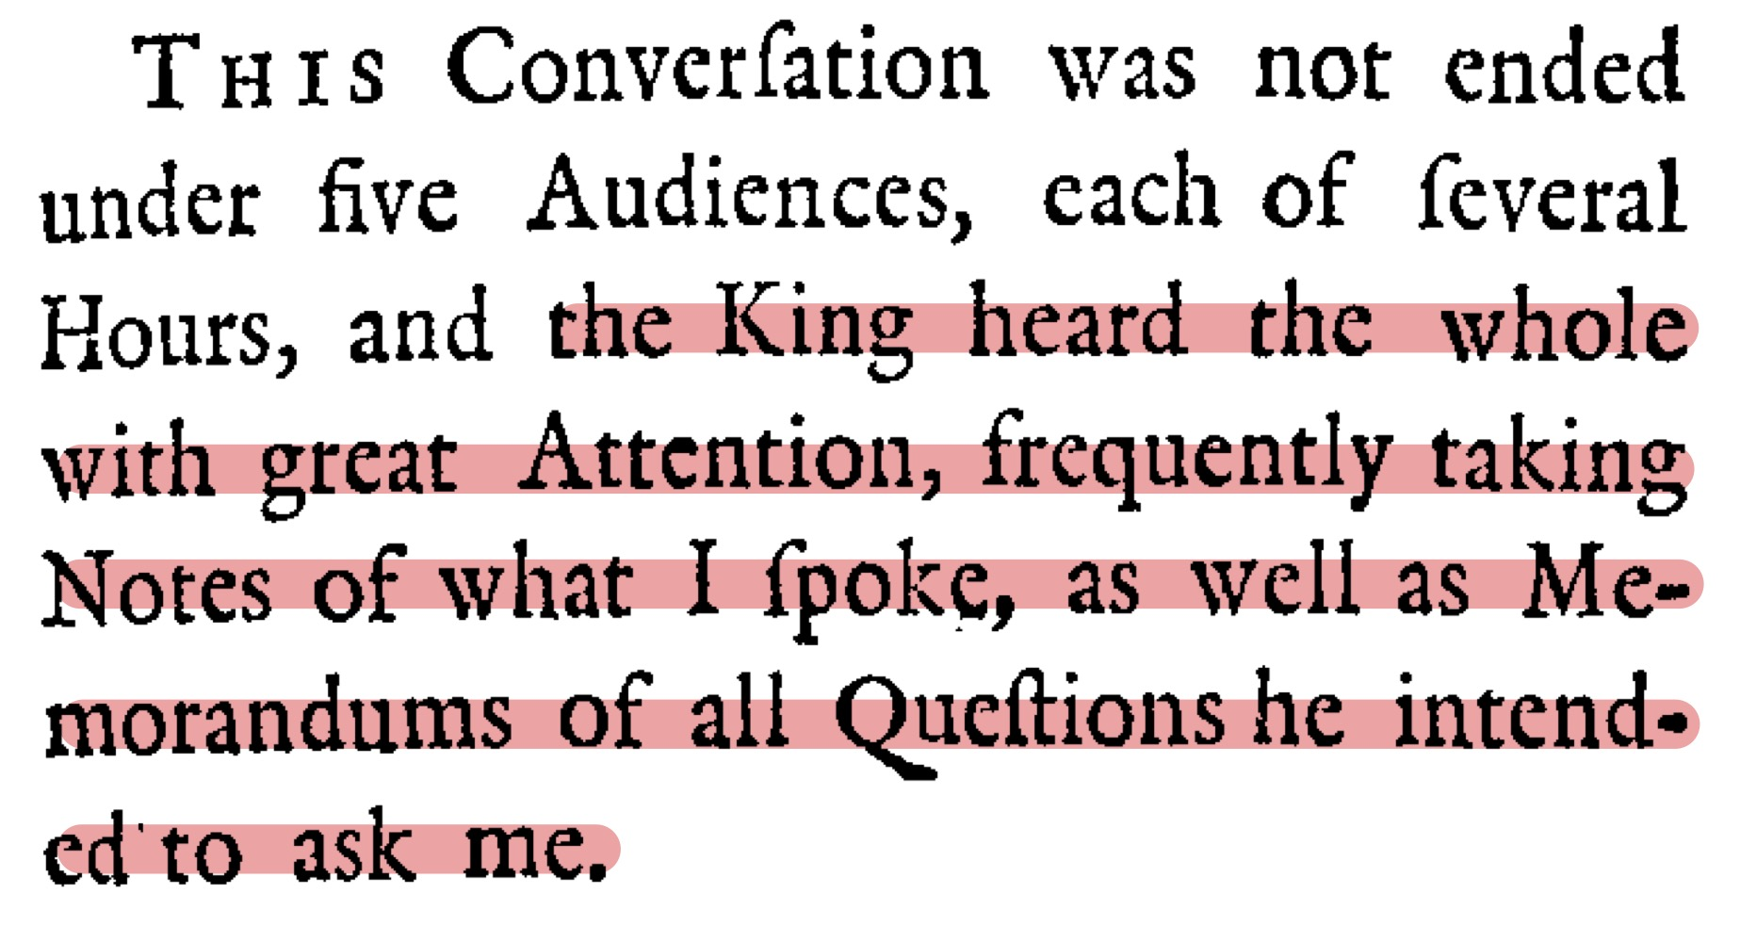
1
Main contents
Chapter VI
Audience 6: the king’s doubts, queries and objections
p111

Slide 6
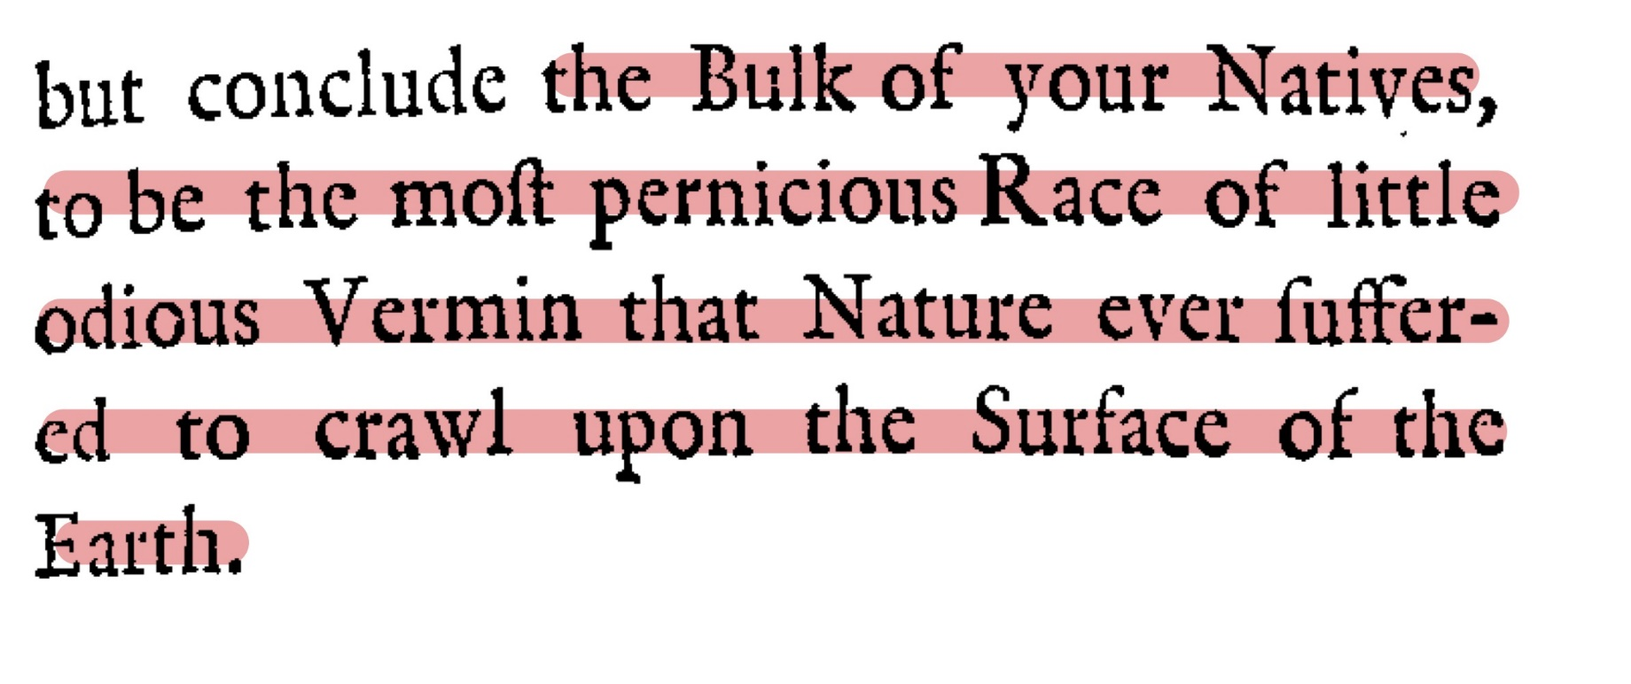
1
Main contents
Chapter VI
Audience 7: the king’s criticism
p119

Slide 7
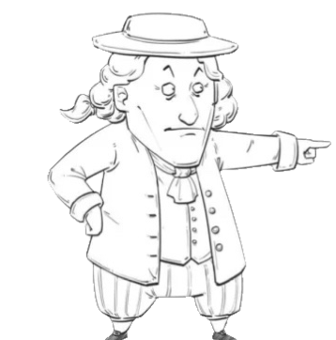
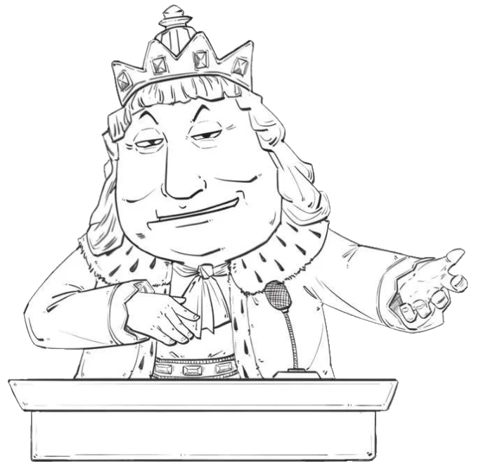
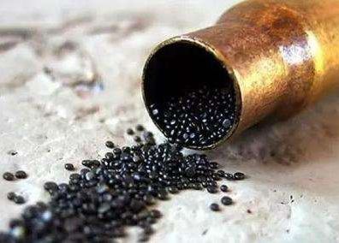
1
Main contents
Chapter VII
1. Gunpowder
Powerful!
Inhuman!
Gulliver
King of Brobdingnag

Slide 8

1
Main contents
Chapter VII
2. Governance
Justice! Lenity!
Politics is a kind of science!
Gulliver
King of Brobdingnag

Slide 9

1
Main contents
Chapter VII
3. Learning
We have developed science and advanced technology!
Our learning is used to improve our lives!
Gulliver
King of Brobdingnag

Slide 10
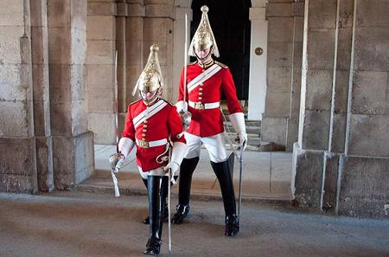
1
Main contents
Chapter VII
4. Military
Colonial expansion!
Deal with civil wars!
Gulliver
King of Brobdingnag

Slide 11
CONTENT
1
2
3
4
Part One
Part Two
Part Three
Part Four
Main contents
Contents we're interested in
Gulliver’s Travels
&
Multiculturalism
Perspectives about the writing style

Slide 12
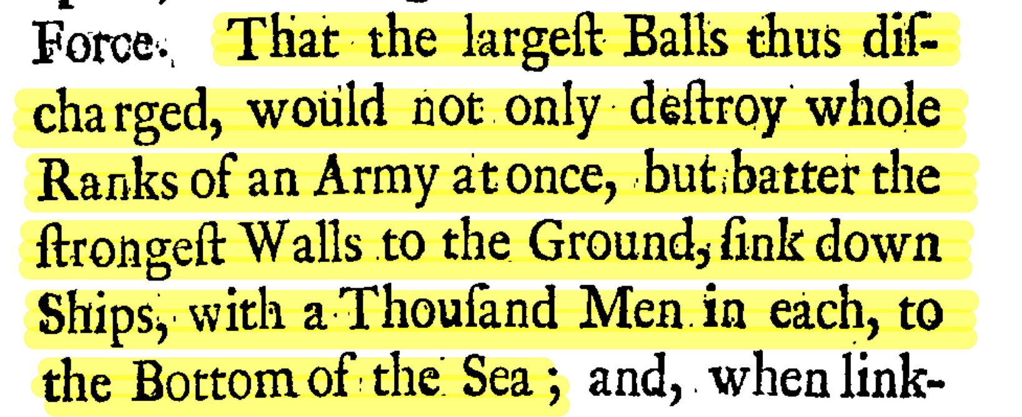
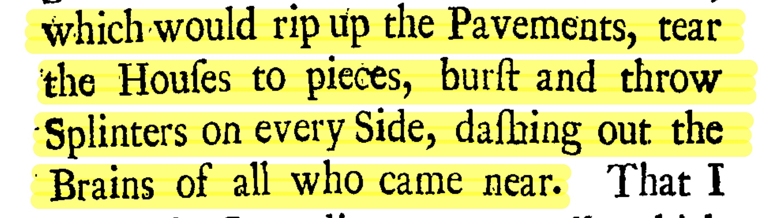
2
Contents we're interested in
The tremendous power of gunpowder
p124
p125

Slide 13
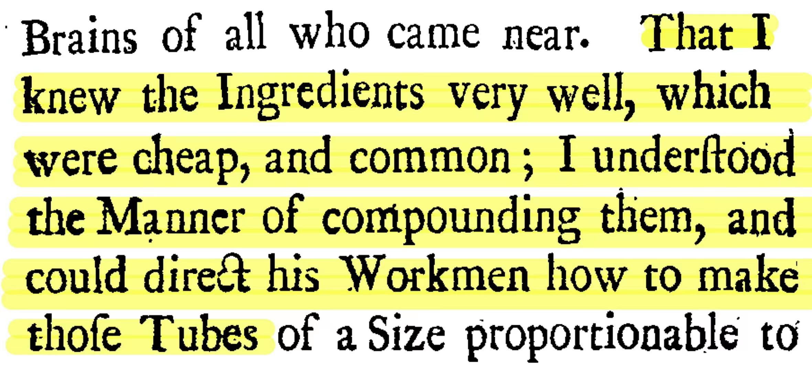
2
Contents we're interested in
Gulliver’s boast
p126

Slide 14
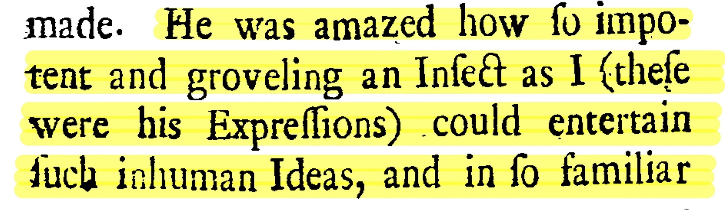
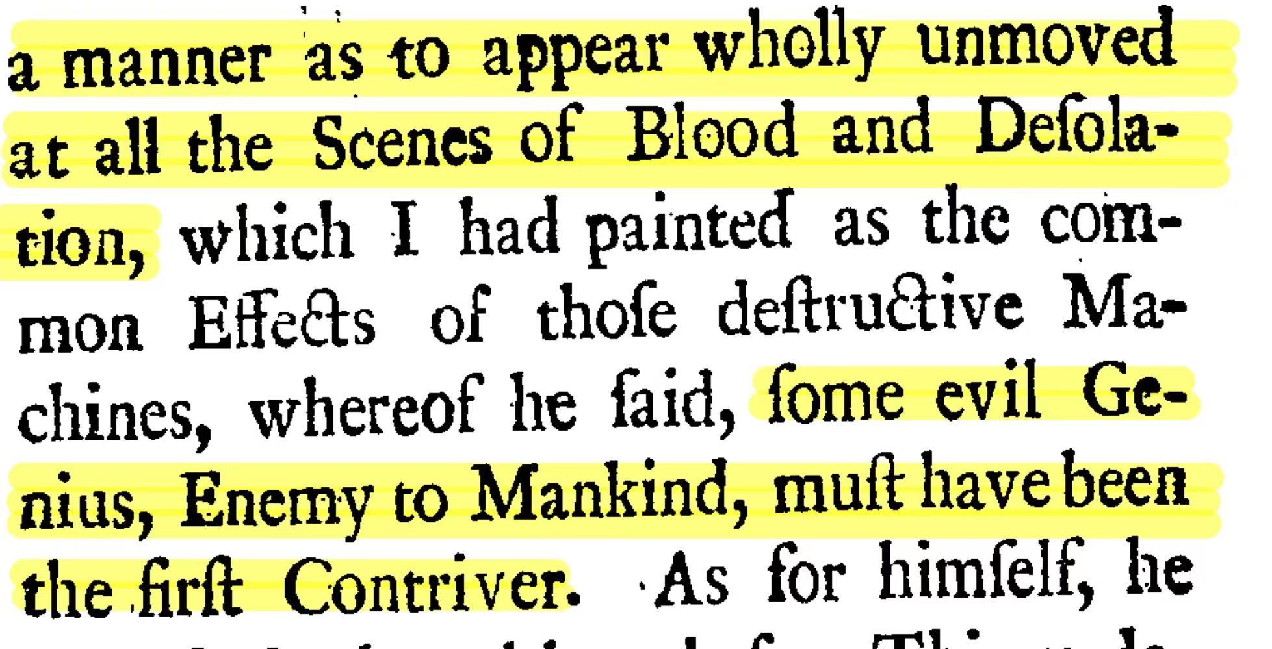
2
Contents we're interested in
King’s attitude
P126-127

Slide 15
CONTENT
1
2
3
4
2
Part One
Part Two
Part Three
Part Four
Main contents
Contents we're interested in
Gulliver’s Travels
&
Multiculturalism
Perspectives about the writing style

Slide 16
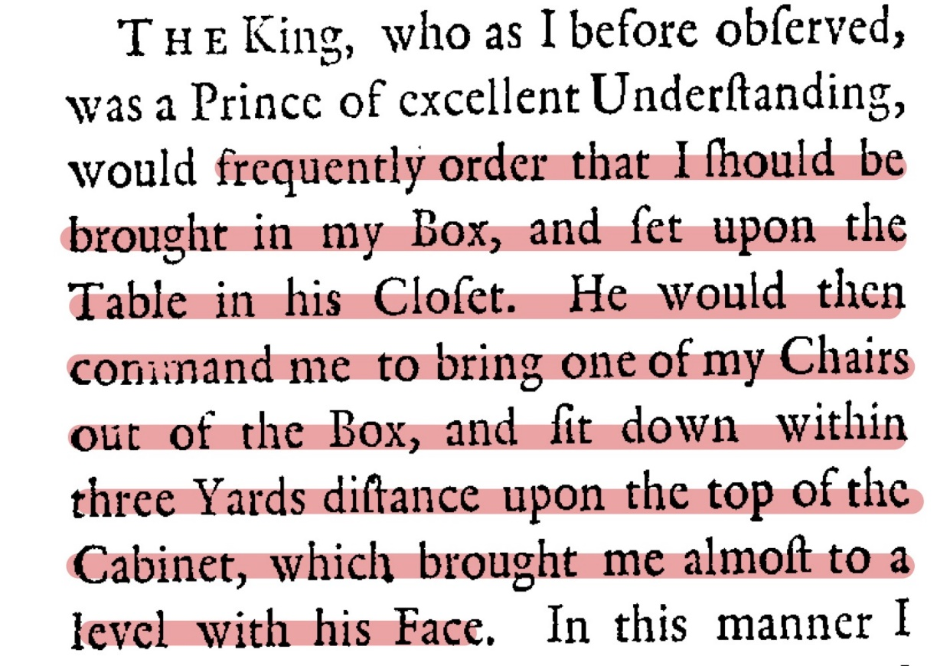
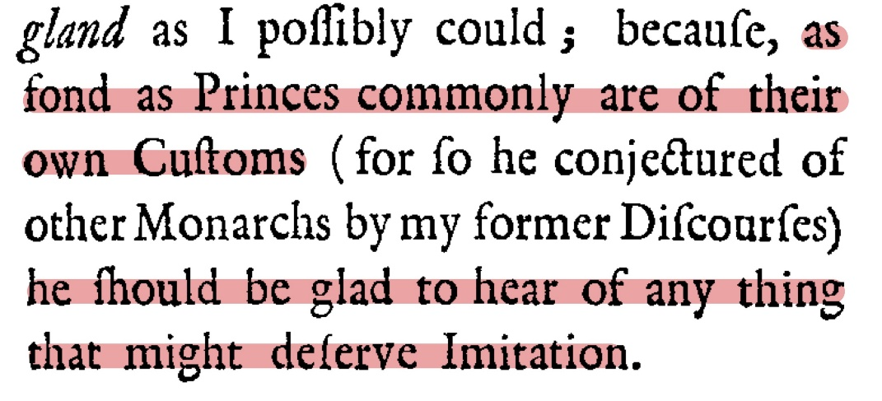
3
Gulliver’s Travels & Multiculturalism
The Seed of Multiculturalism
p107
p106

Slide 17
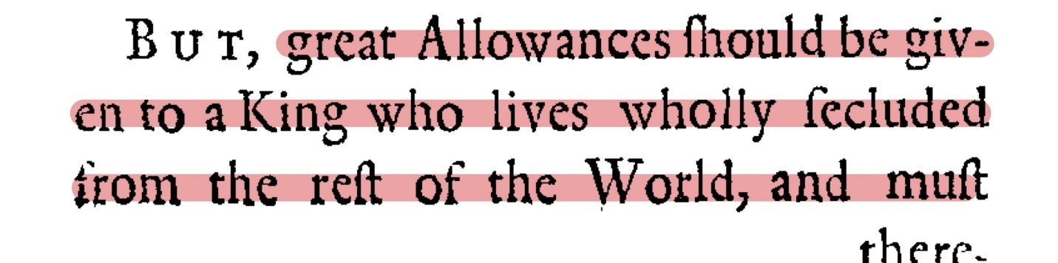
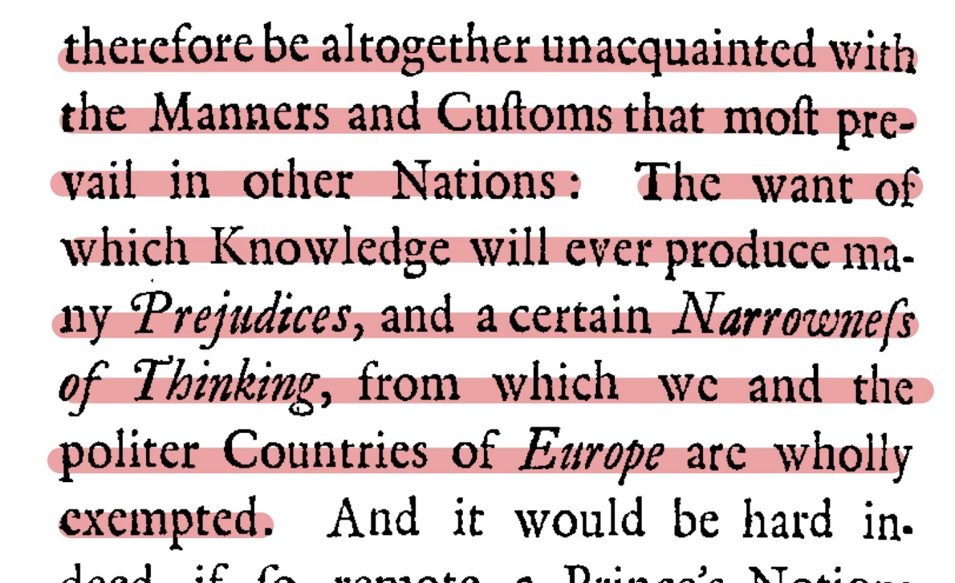
3
Gulliver’s Travels & Multiculturalism
However…
two reasons for the conflict:
1. Cultural superiority
p123,124

Slide 18
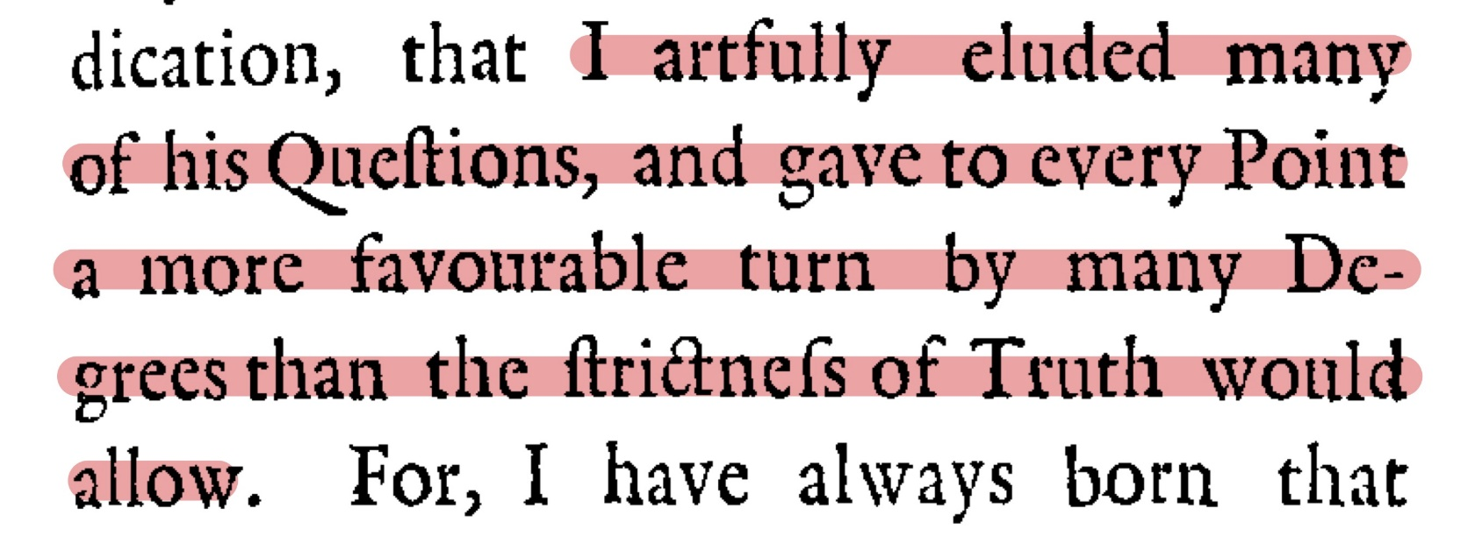
3
Gulliver’s Travels & Multiculturalism
2. The eager to prove oneself right
p123

Slide 19
3
Gulliver’s Travels & Multiculturalism
Comparison → Understanding
“Contemporary cultural theory is very much in favor of multiculturalism, with its implicit assumption that no one culture or way of life is superior to any other and that cultural difference need not lead to conflict, that in fact it can be mutually inspiring and help to engender a more tolerant world order.”
Gulliver’s Travels, Multiculturalism and Cultural Difference, p35

Slide 20
3
Gulliver’s Travels & Multiculturalism
 | England | Brobdingnag
Advantages | Advanced science and technology Well-developed political system Strong military strength | Rationality, justice and kindness
Disadvantages | Brutal and greedy colonization Domestic party struggles | Incomplete laws and systems

Slide 21
3
Gulliver’s Travels & Multiculturalism
Understanding → Learning

Slide 22
CONTENT
1
2
3
4
Part One
Part Two
Part Three
Part Four
Main contents
Contents we're interested in
Gulliver’s Travels
&
Multiculturalism
Perspectives about the writing style

Slide 23
4
Perspectives about the writing style
Plain style

Slide 24
4
Perspectives about the writing style
“we conclude that the diction of the plain style is that of ordinary even everyday words, the sentence structure of it is more or less the oral subject-predicate-object order, and the density of figurative language is quite loose, or at least ostensibly so.”

Slide 25
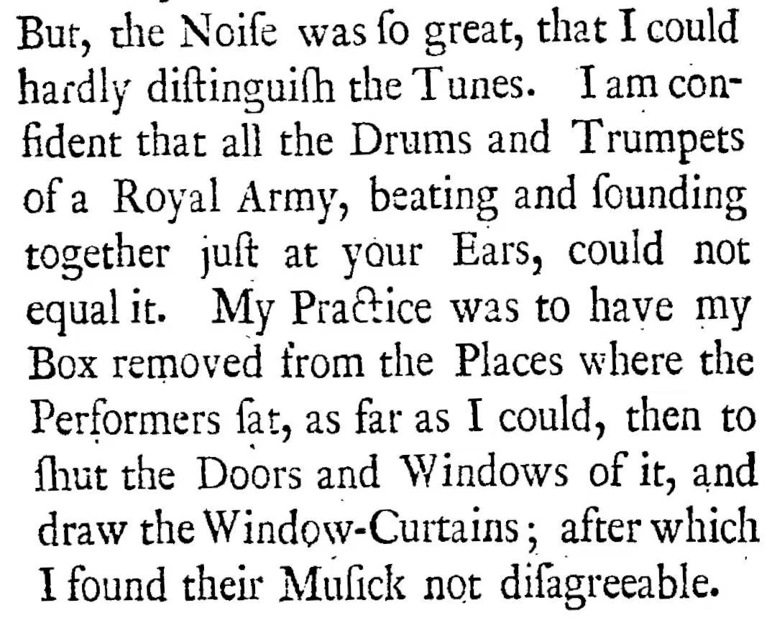
4
Perspectives about the writing style
Plain narration of an abnormal concert

Slide 26
4
Perspectives about the writing style
Plain style
Authenticity

Slide 27
4
Perspectives about the writing style
Why Swift needs the Authenticity
when creating a fantasy world?

Slide 28
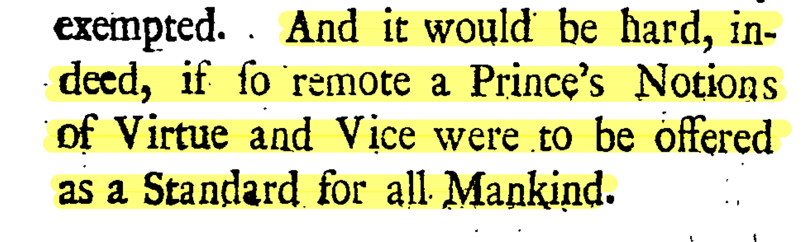
4
Perspectives about the writing style
Gulliver’s dispute against king’s moral standard

Slide 29
4
Perspectives about the writing style
Authenticity
Sharpened irony

Slide 30
Thank you for watching

